Slide 1
Review: Deep Implicit Statistical Shape Models for 3D Medical Image Delineation
Segmentation 팀장 신현호

Slide 2
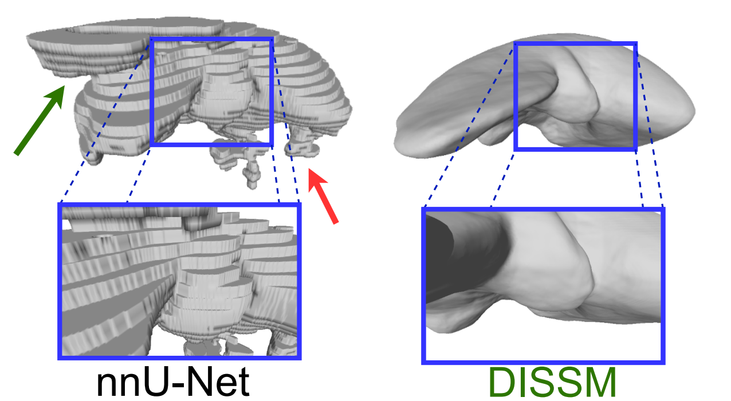
Preview: Conclusion
DISSM represents a new and promising approach to 3D medical imaging delineation!

Slide 3
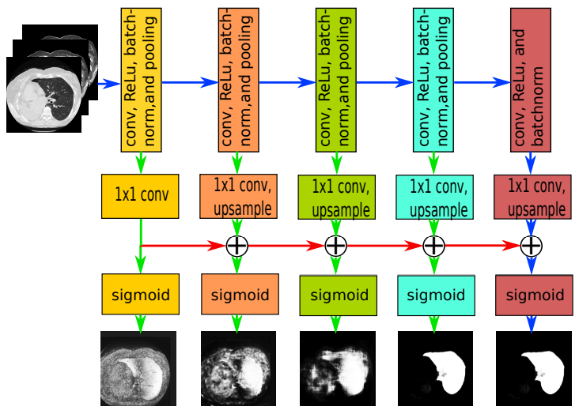
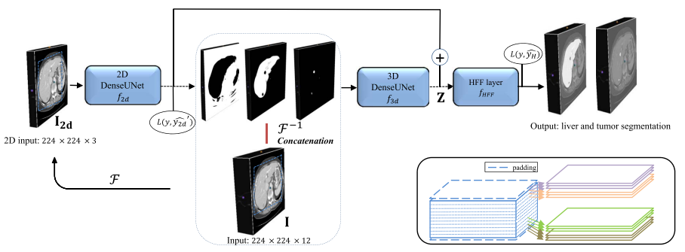
Recent History
Progressive Holistically-Nested Network
P-HNN (2017)
Using 2D FCN backbone
H-DenseUNet (2018)
Cascade of 2D & 3D FCNs
nnU-Net (2021)
Using 3D FCN Cascade
Mainly rely on FCN
Hybrid Densely Connected Unet

Slide 4
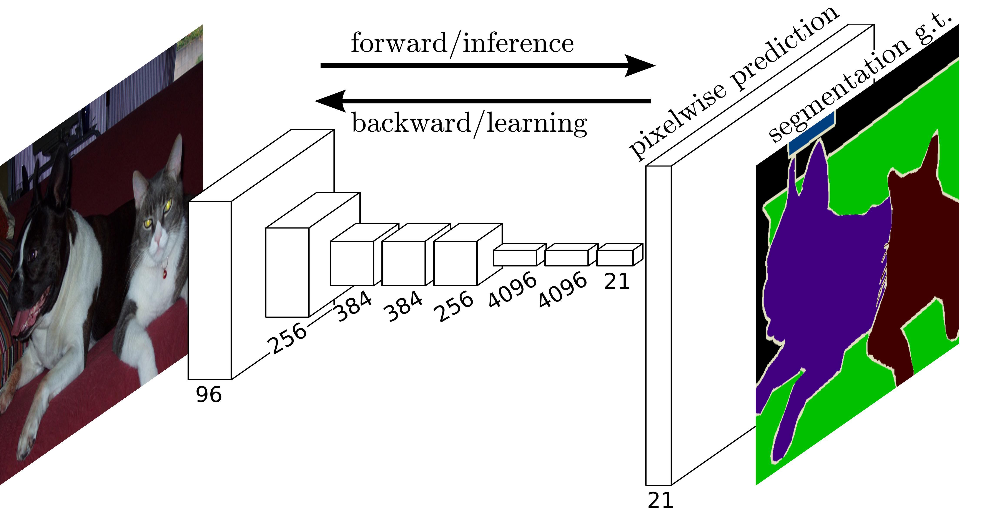
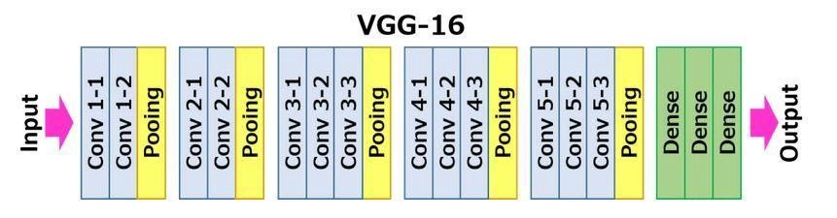
Fully Convolutional Networks for Semantic Segmentation (2014)
J. Long et al., 2014, Cited by 34892

Slide 5
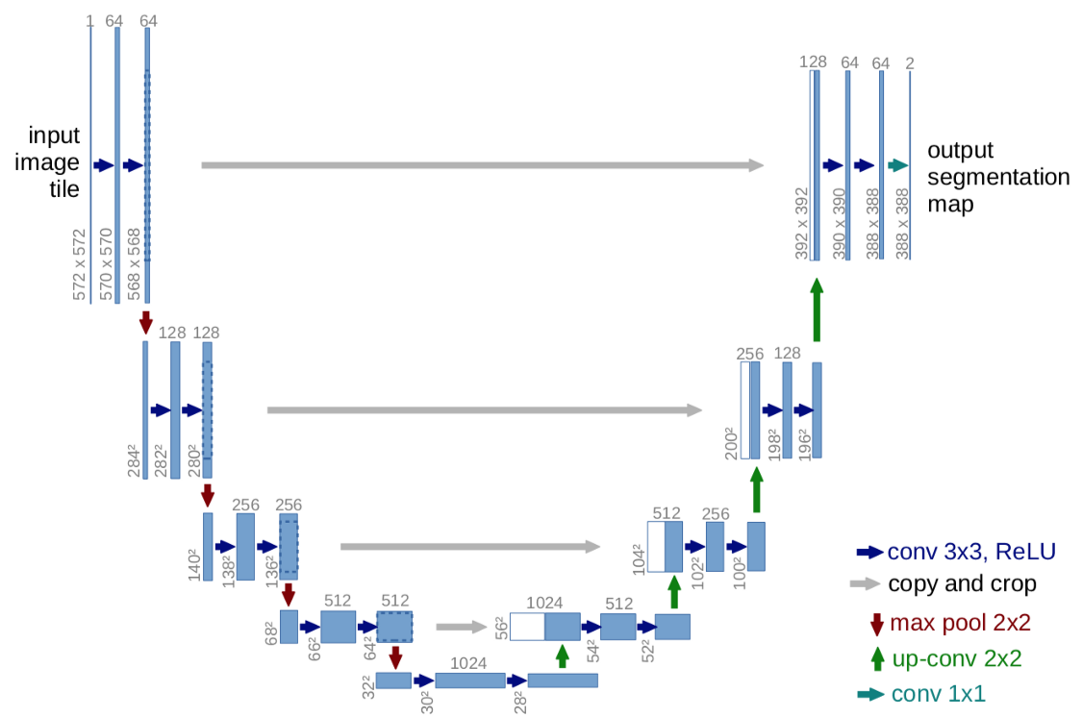
3D Medical Image Delineation
Progressive Holistically-Nested Network
P-HNN (2017)
Using 2D FCN backbone
H-DenseUNet (2018)
Cascade of 2D & 3D FCNs
nnU-Net (2021)
Using 3D FCN Cascade
U-Net (2015)
Hybrid Densely Connected Unet

Slide 6
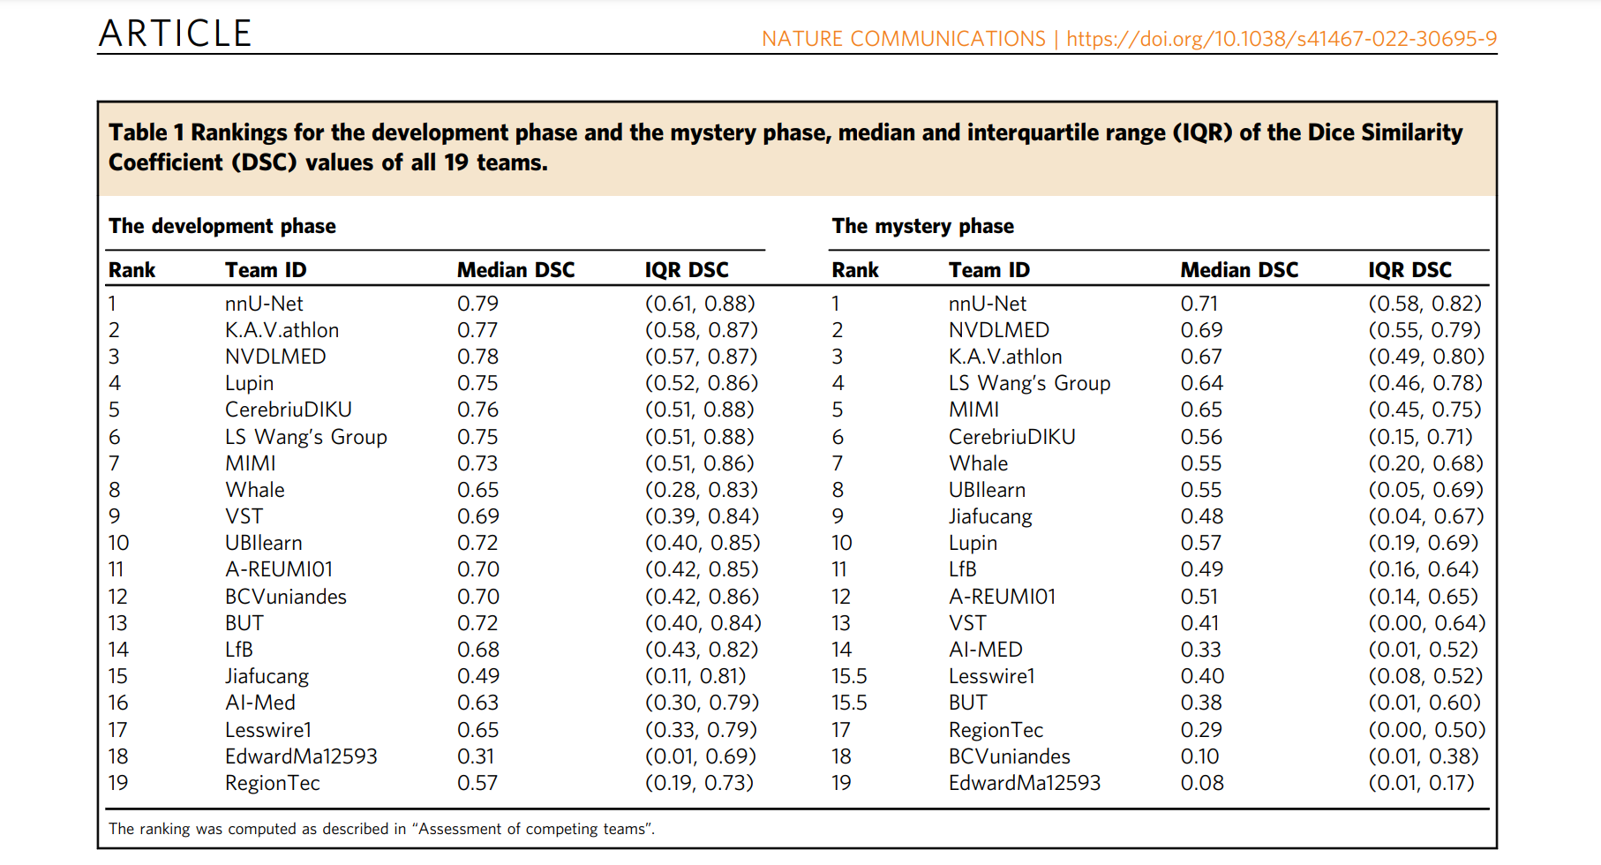
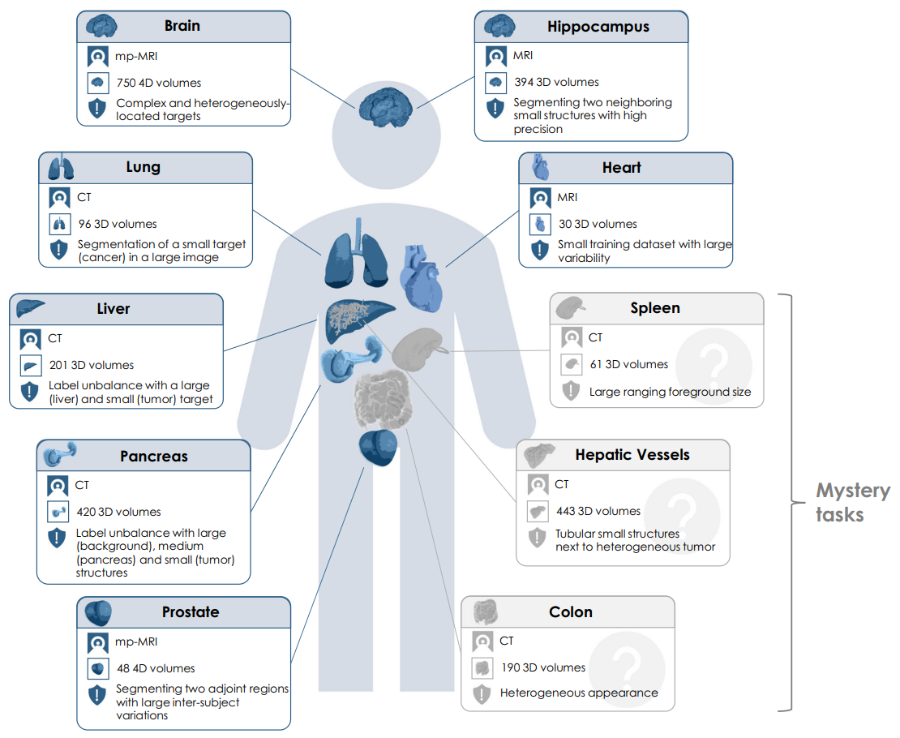
Medical Segmentation Decathlon (Challenge)

Slide 7
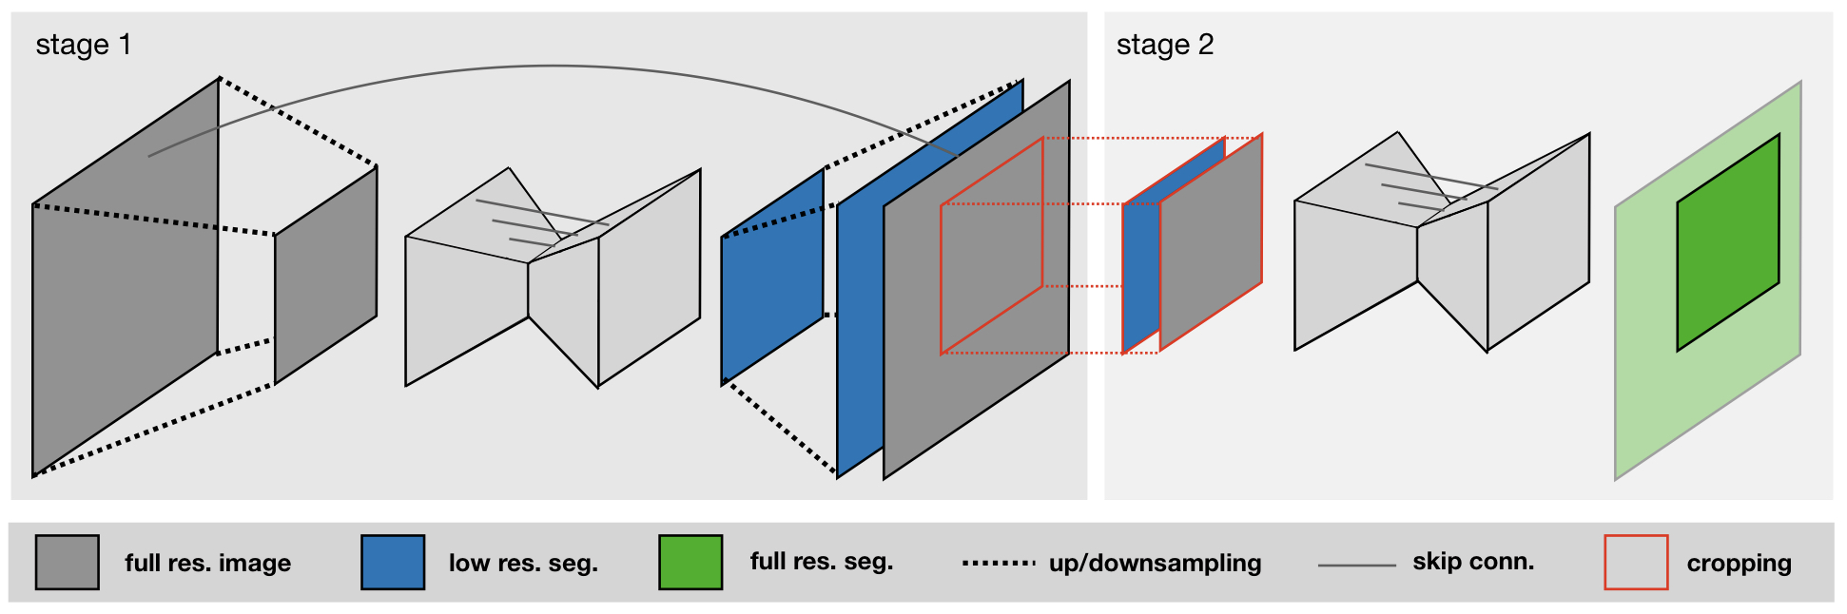
nnU-Net (no-new-U-Net)
automatically configures itself:
Preprocessing
Network Architecture[no-new]
Training
Post-processing
focused on pre- & post-processing
Hard to customize, adopt
F. Isensee et al., 2021, Cited by 905

Slide 8

Beyond nnU-Net: MONAI Framework (*API)
Important!
Widely in use instead of nnU-Net(*project)

Slide 9
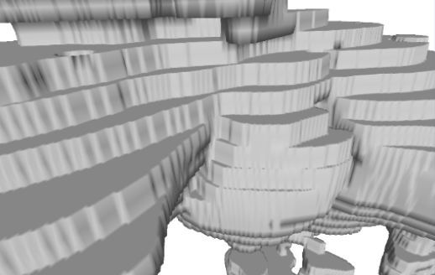
nnU-Net (no-new-U-Net)
Limitations: as the author states,
Discretization (pixel, slide)
Low Quality (=Low Resolution)
Fails in other scenarios not seen in training
Small Datasets!
≠ Real liver (continuous)

Slide 10
DISSM: to overcome the limitations
TACE*
Treated
Lesion
Cardiac
Region
HOW?
*TACE: Transarterial chemoembolization

Slide 11
DISSM for 3D Medical Delineation
Deep Implicit Statistical Shape Model
Implicit Representation
Deep Learning
SSM [no-new]

Slide 12


1. Implicit Representation: Example
Microsoft Paint
GeoGebra
(dynamic mathematics software)

Slide 13
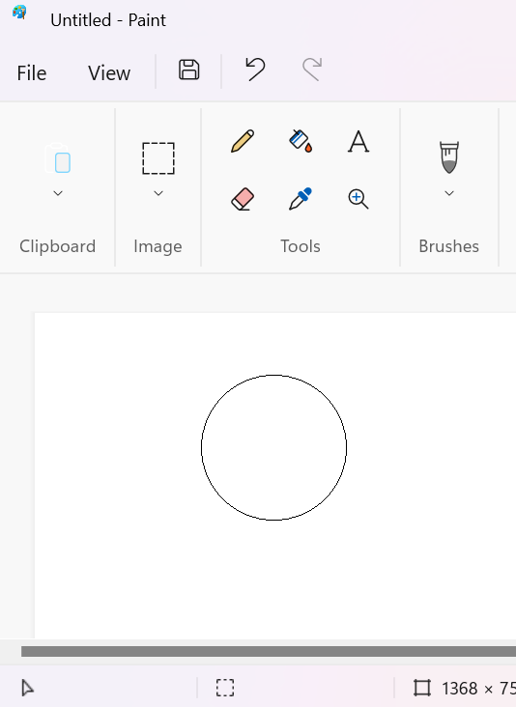
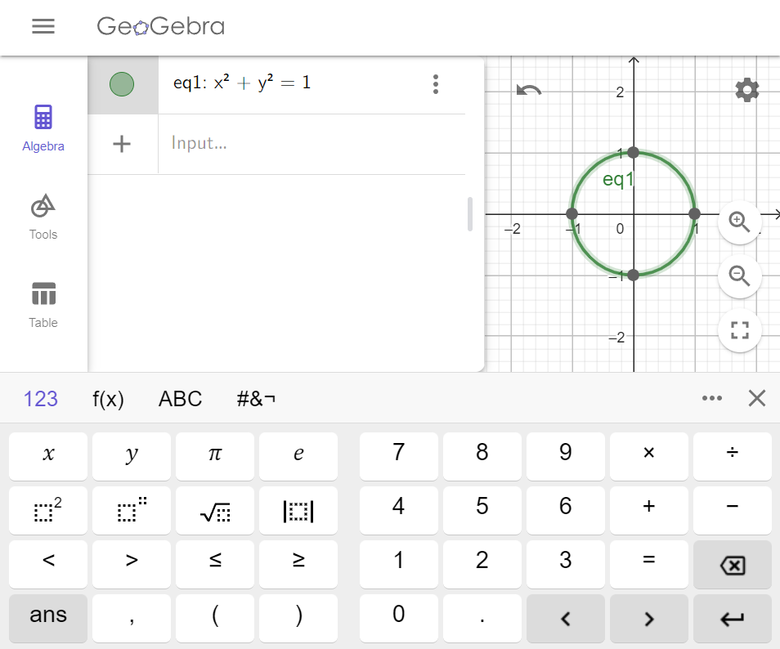
Explicit/Implicit Circle
Explicit Representation
Implicit Representation

Slide 14
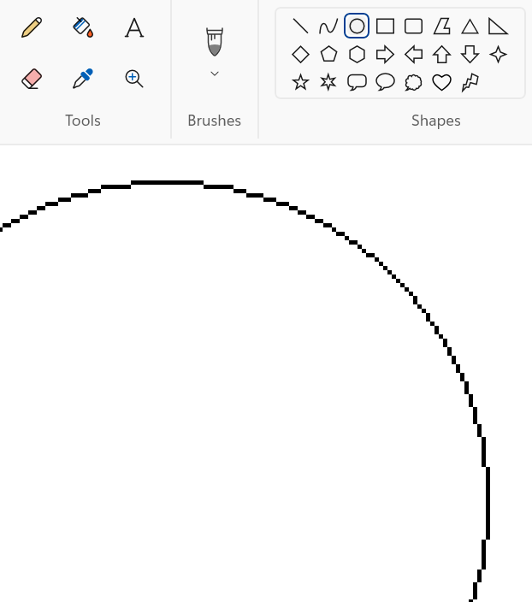
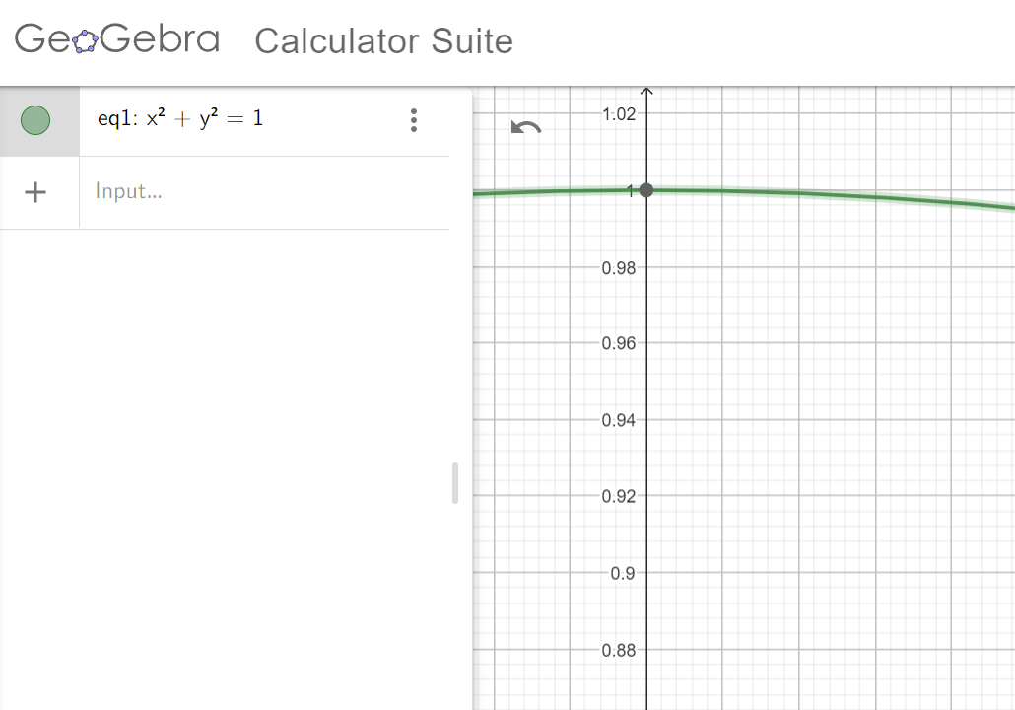
500% Zoom In
Implicit Representation: To find a function, not an image
(SDF)
Explicit: Limited Resolution
Implicit: Infinite Resolution
1000%

Slide 15
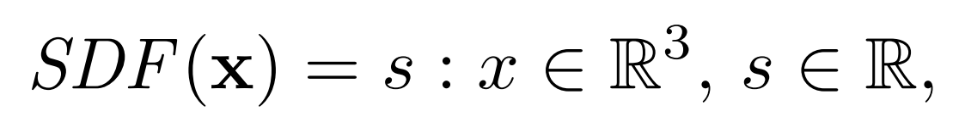
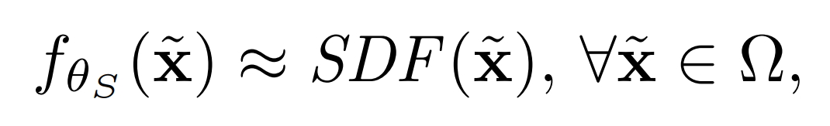
Signed Distance Function (SDF)
Deep Implicit Shape (Park et al., 2019)
Deep MLP can be trained to approximate a shape’s SDF

Slide 16
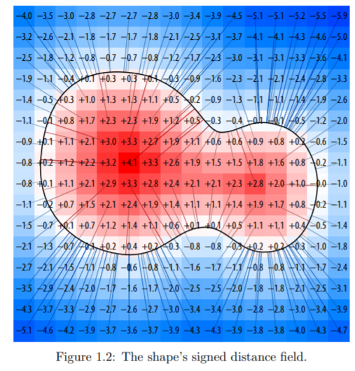
HOW?

Slide 17
Signed Distance Function (SDF)
Deep Implicit Shape (Park et al., 2019)
Deep MLP can be trained to approximate a shape’s SDF

Slide 18
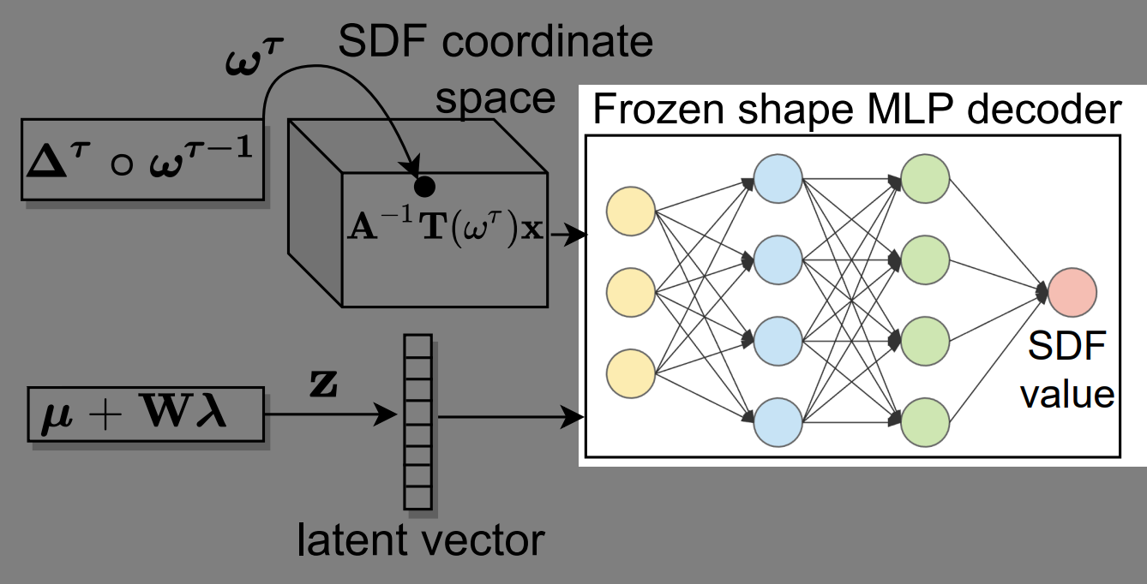
Shape Decoder (MLP) not FCN

Slide 19
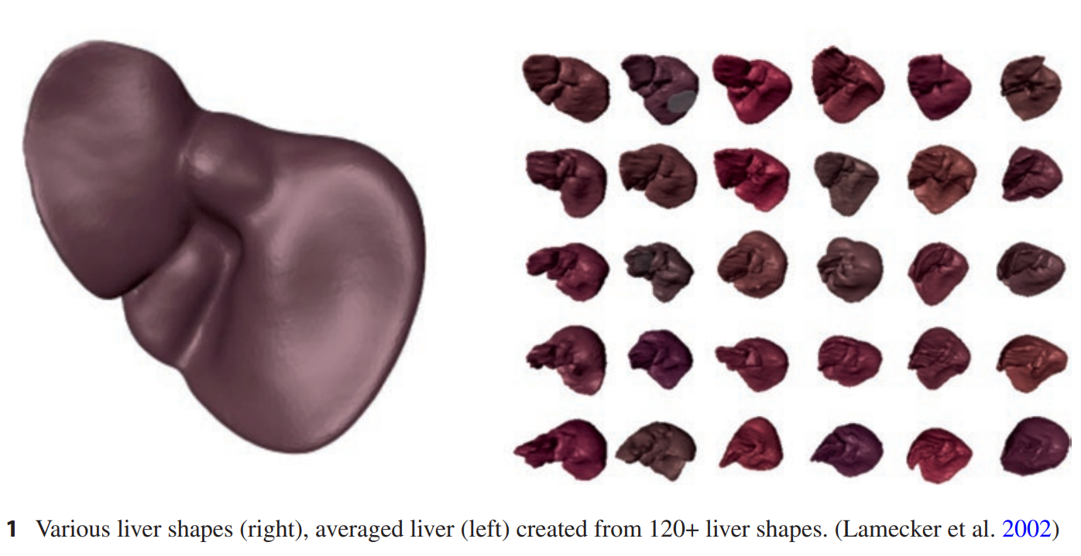
2. SSM (Statistical Shape Model)
Pre-existing concept [no-new]
Geometric models describing semantically similar objects
Representing an average shape of 3D objects as well as their variation in shape
Average shape: Rigid pose
Variation: Non-rigid pose

Slide 20
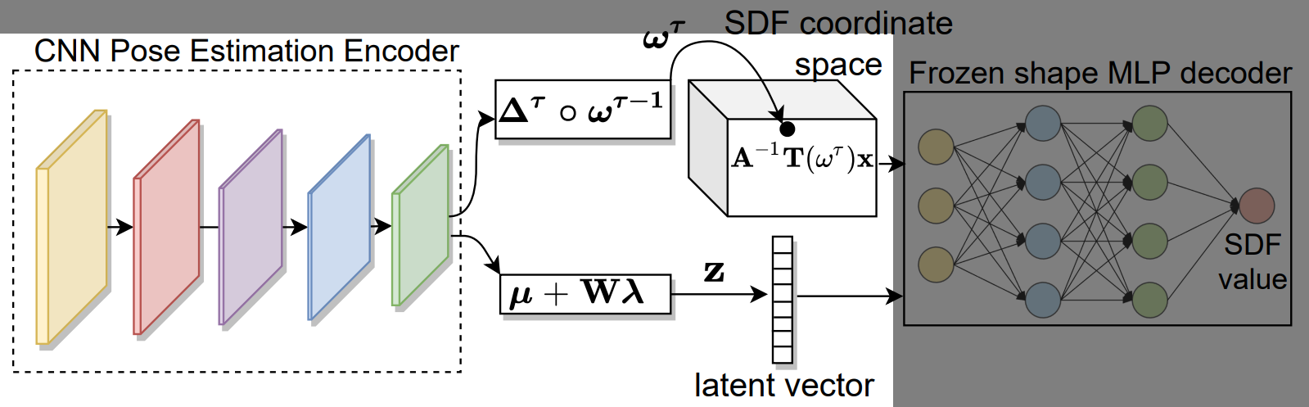
CNN Pose Estimation Encoder

Slide 21
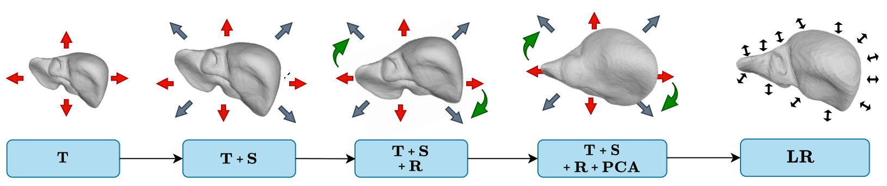
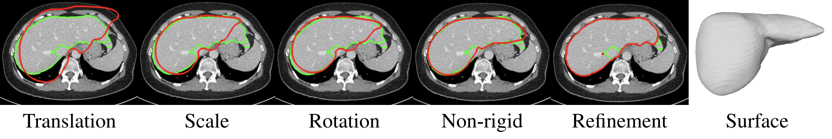
Pose Estimation Process
Rigid Pose
Non-rigid Pose
Red: prediction, Green: ground truth

Slide 22
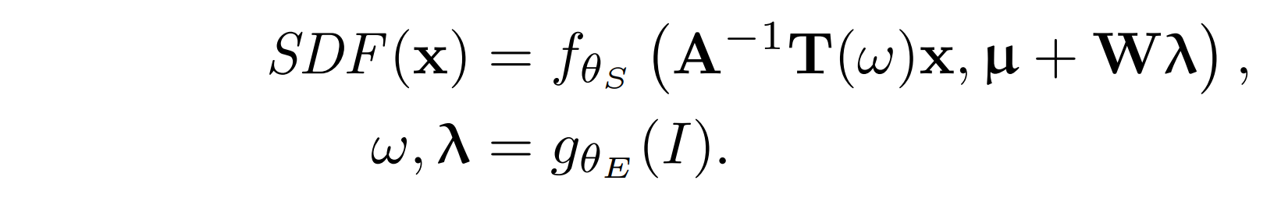
Encoder g_{θE}(I)
Encoder Input: Image // Decoder Output: SDF (not same)
[Decoder]
[Encoder]
how to scale, how to rotate, …
Encoder predicts ω (rigid pose parameters), λ (non-rigid PCA loadings)
Directly Predict? Too sensitive to Errors

Slide 23
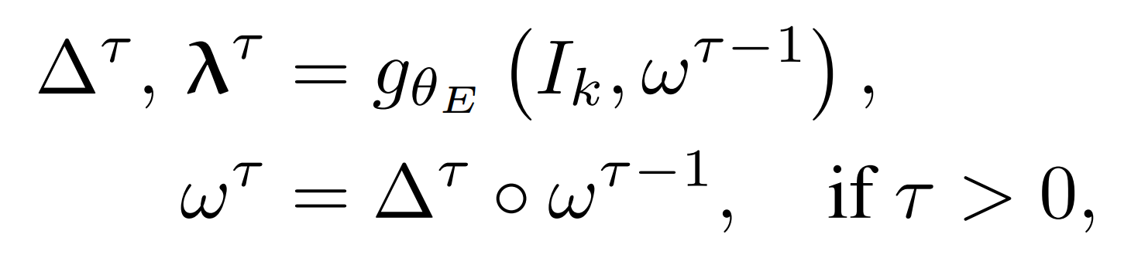
Markov Decision Process (MDP)
Popular in Reinforcement Learning
Initial pose: ω⁰
Current step: τ
Interpret the encoder as an “agent” that predicts corrections to the previous pose!

Slide 24
Experiment: Labeled Datasets
131 Liver CT Image (Simpson et al., 2019)
Train : Validation : Test = 7 : 2 : 1
97 Liver CT Image (Raju et al., 2020)
Test Only
142 Larynx CT Image
What for?
What for?

Slide 25
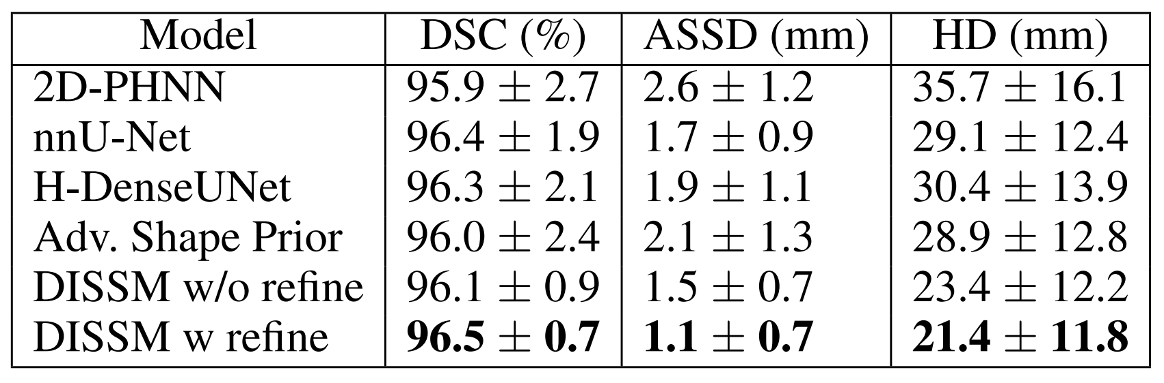
Results: Liver 1
DSC: Sørensen-Dice Coefficient (higher is better)
ASSD: average symmetric surface distance (shorter is better)
HD: Hausdorff distance (shorter is better)
‘F1 score’ in Image Segmentation
Table 2: Quantitative results on the MSD liver dataset.

Slide 26
Refinement
non-rigid pose estimation fails to capture very fine detail
Surface Refinement with FCN Model
Michalkiewicz et al., 2019

Slide 27
Results: Liver 1
DSC: Sørensen-Dice Coefficient (higher is better)
ASSD: average symmetric surface distance (shorter is better)
HD: Hausdorff distance (shorter is better)
‘F1 score’ in Image Segmentation
Table 2: Quantitative results on the MSD liver dataset.

Slide 28
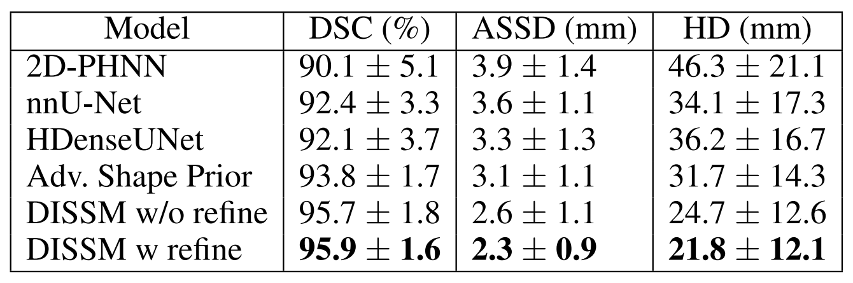
Results: Liver 2
Table 3: Cross-dataset results on the clinical liver dataset.

Slide 29
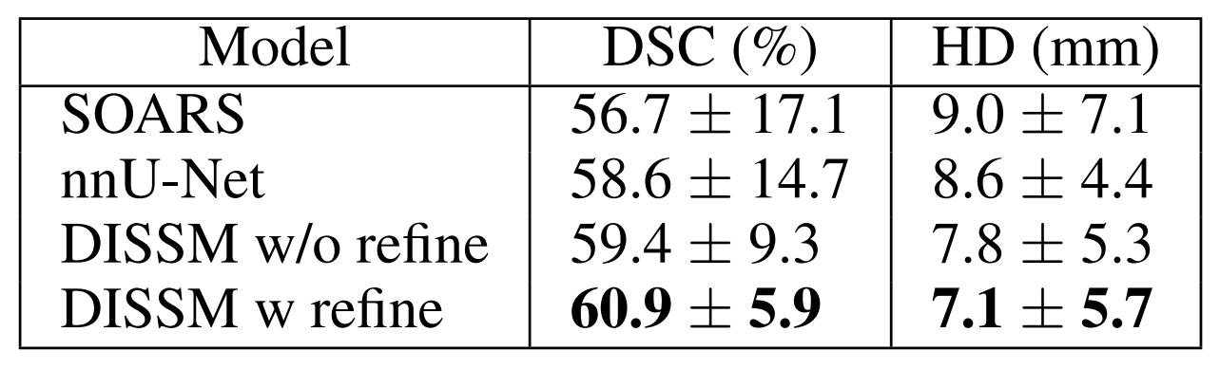
Results: Larynx
*SOARS: stratified Organ at Risk segmentation model (Guo et al., 2020)
Table 4: Larynx dataset results.

Slide 30
Conclusion: Author
DISSM directly outputs high-quality surfaces. (NO voxelized masks)
“DISSM outperforms leading FCNs.”
DISSM is a new and promising approach to 3D medical imaging delineation.

Slide 31
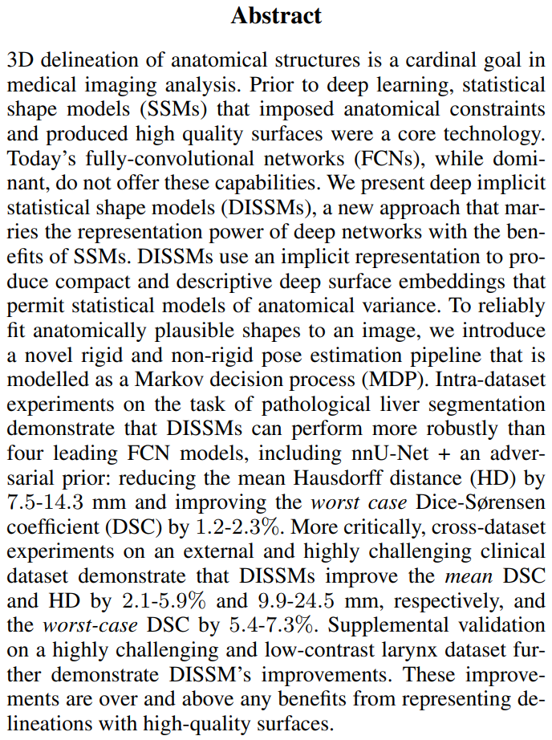
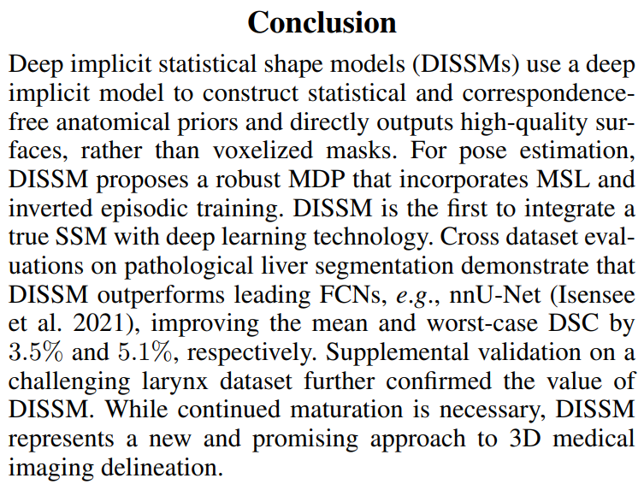

Slide 32
Drawbacks
DISSM relies on FCN (Surface Refinement)
Critical factor: ‘Implicit Representation’ or ‘SSM’
Alternative Network w/o Implicit Shape Decoder?

Slide 33
결론: 연구
Segmentation 분야 선행 연구가 상당히 많음 (cf: Recent History)
FCN, Unet, nnUNet에 대한 이해도 필요
새로운 아이디어를 통해 기존에 없던 새로운 시도를 해야 함
새로운 시도는 무에서 유를 창조하는 과정이 아님
이미 존재하는 개념과 도구를 적절히 조합, 활용해서 새로운 방법론 제시할 수도 있음
선행 연구, 라이브러리, 프레임워크에 대한 이해 및 연습 필요
nnUNet의 사례를 볼 때, MONAI Framework의 중요성이 매우 클 것으로 전망됨

Slide 34
결론: 연구
기존 모델과 비슷한 성능을 내는 것만으로는 부족함
논문의 저자는 FCN을 써서라도 기존 모델보다 명확히 뛰어난 모델 제시 (+추가 데이터셋)
outperforming model이 필요
Metrics에 대한 공부도 필요
Segmentation 분야에서 쓰는 특수한 머신러닝 평가지표(ex. Dice metrics)에 대한 공부
3D & Multi-organ segmentation으로 확장
2D segmentation만 가지고는 논문 내기 어려움

Slide 35
결론: 논문 작성
이론의 전개 순서가 반드시 process의 순서와 일치할 필요는 없음
[예시] 강조하고 싶은 부분을 앞으로, 취약한 부분을 뒤로 배치
논문의 저자는 취약한 Surface Refinement(FCN)를 가장 뒤로 배치
그 결과 Implicit Statistical Decoder가 가장 앞으로 이동

Slide 36
Further Readings
https://github.com/hyun-hoshin/snuimageseg/tree/main/References/1.%20DISSM

Slide 37
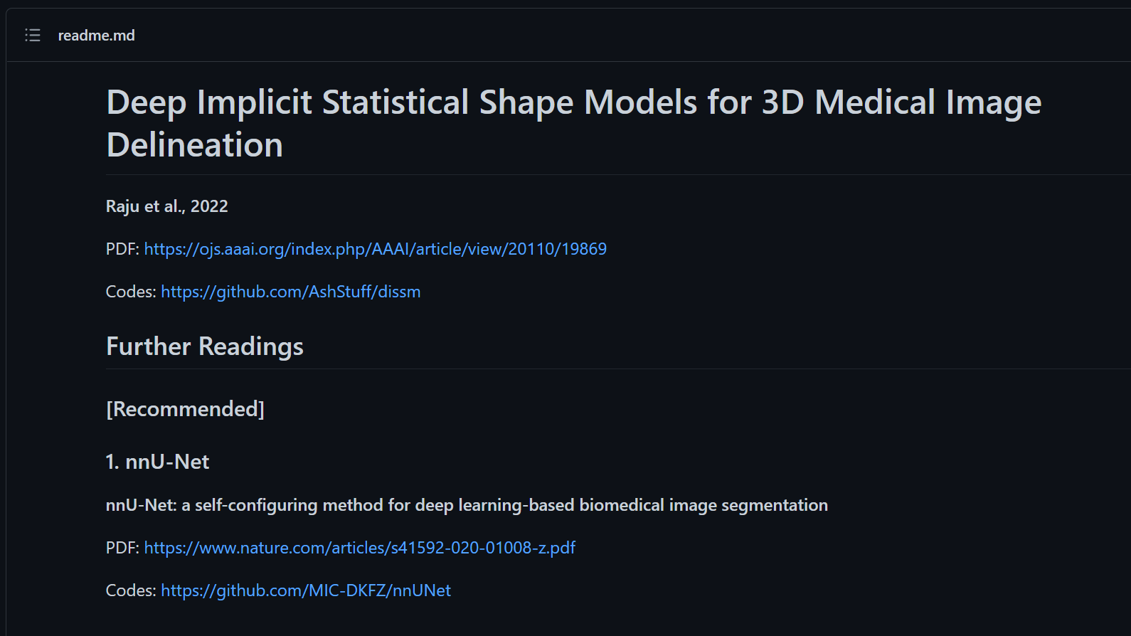

Slide 38
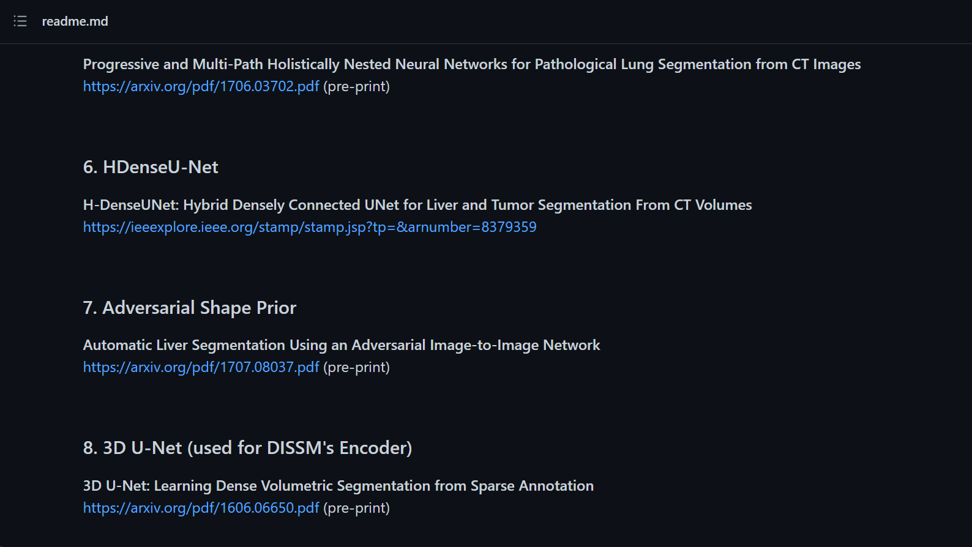

Slide 39
Thank You
감사합니다.

